Slide 1
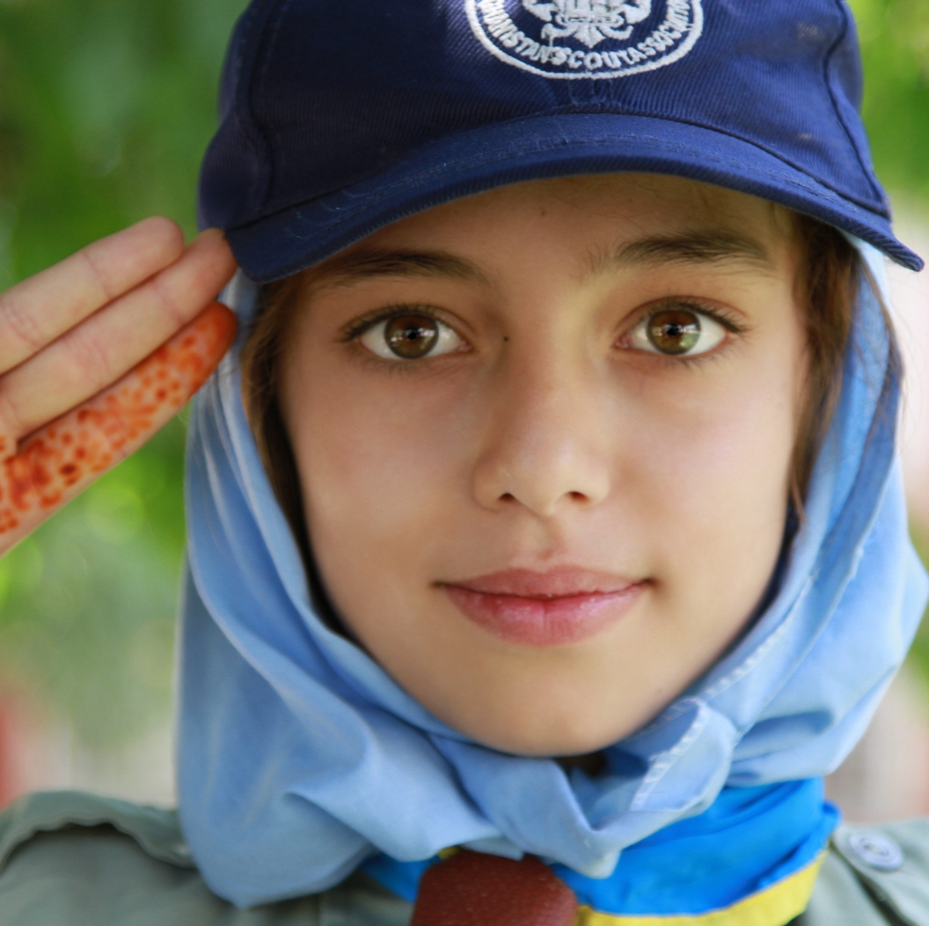


Afghan Scouts
A PARSA Program

Slide 2
PARSA
Building Healthy Afghan Communities
Founded in 1996, PARSA is a non-governmental organization that works directly with disadvantaged Afghans by supporting local Afghan leaders in their efforts to effect change in their communities. PARSA focuses on promoting social change and a healthy and fair society for all people but especially women and children.

Slide 3
PARSA’s Afghan Scouts
PARSA’s Afghan Scouts is a national program for Afghan youth that promotes community service, fosters national unity, and helps develop strong youth leaders who will contribute to the rebuilding of Afghanistan.

Slide 4
History of the Afghan Scouts
The Afghan Scouts were founded in 1931 by King Nadir Shah.
Over 36,000 girls and boys were enrolled in the Afghan Scouts by the 1970s.
The Scouting movement diminished after the Soviet invasion of 1979.
The Ministry of Education attempted to restart Scout programs in the early 2000s, but they were unsuccessful.
In 2008, with permission from the Ministry, PARSA began efforts to begin two Scout troops in Kabul orphanages.

Slide 5
History of the Afghan Scouts
2008 - 2012
In 2010, the U.S. Embassy awarded PARSA a small grant to start rebuilding the Scout program.
PARSA recruited Scout staff, trained Scout Masters, and by the end of 2011 had over 700 active Scouts in orphanages in Kabul and Ghor Provinces.
An international group called Scouts for Afghan Scouts helped PARSA renovate a building that became the first National Scout Training Center.

Slide 6
History of the Afghan Scouts
2013 - present
The Scouts have grown into a nationally-recognized program.
Funding from the U.S. Embassy and support from the World Organization of the Scout Movement helped the Scouts :
Develop unique badge programs, such as “Messengers of Peace” and “Scouts Go Solar”.
Participate in international Scouting events.
Conduct annual “Camporee” events where Scouts from across the country meet and learn together.

Slide 7
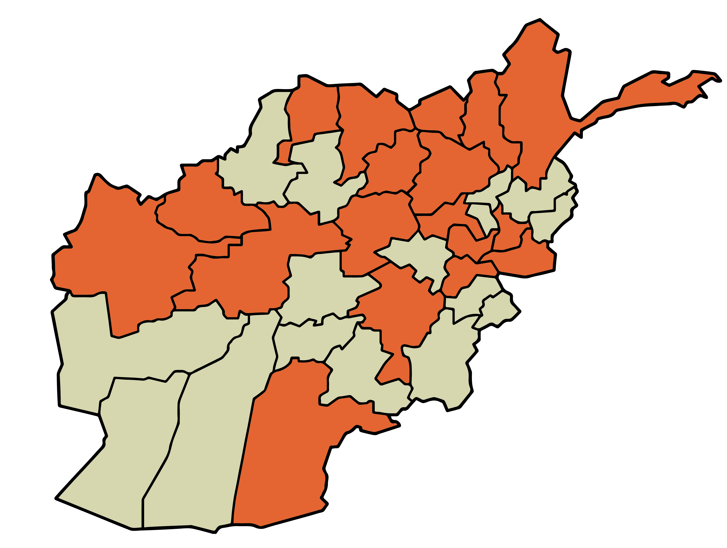
Afghan Scouts Today
Over 2,000 youth are registered in 18 provinces
66 volunteer Scout Masters
30% of Scouts are girls
11 merit badges
15 “Legacy Scout
Masters” (pre-1979
Scouts who support
Scouting today)

Slide 8
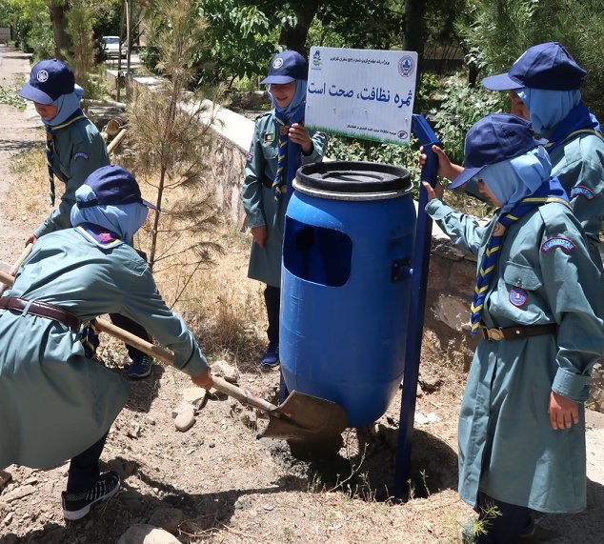
Activities: Community Service
Examples of community services activities initiated by the Scouts”
Hospital visits, delivery of hygiene packages
Garbage cleanup and bin installation
Repairing school buildings
Painting traffic signs

Slide 9
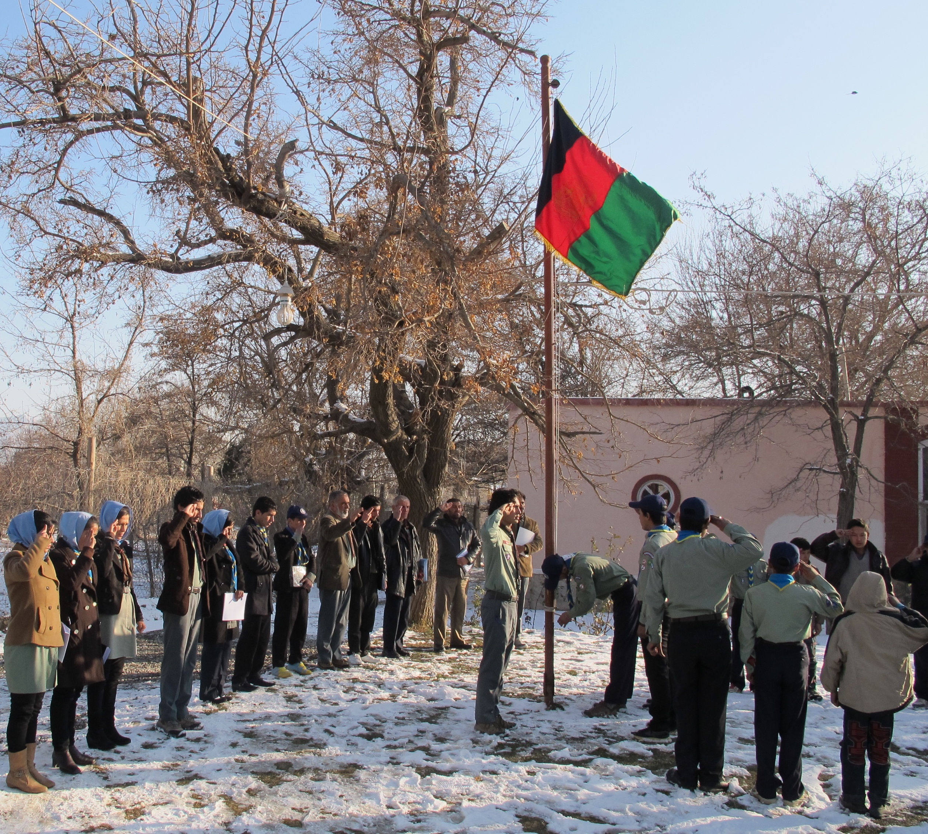
Activities: Troop Meetings
At weekly troop meetings, Afghan Scouts:
Learn new skills, play games that teach leadership and team-building
Plan troop activities
Go on field trips
Earn merit badges

Slide 10
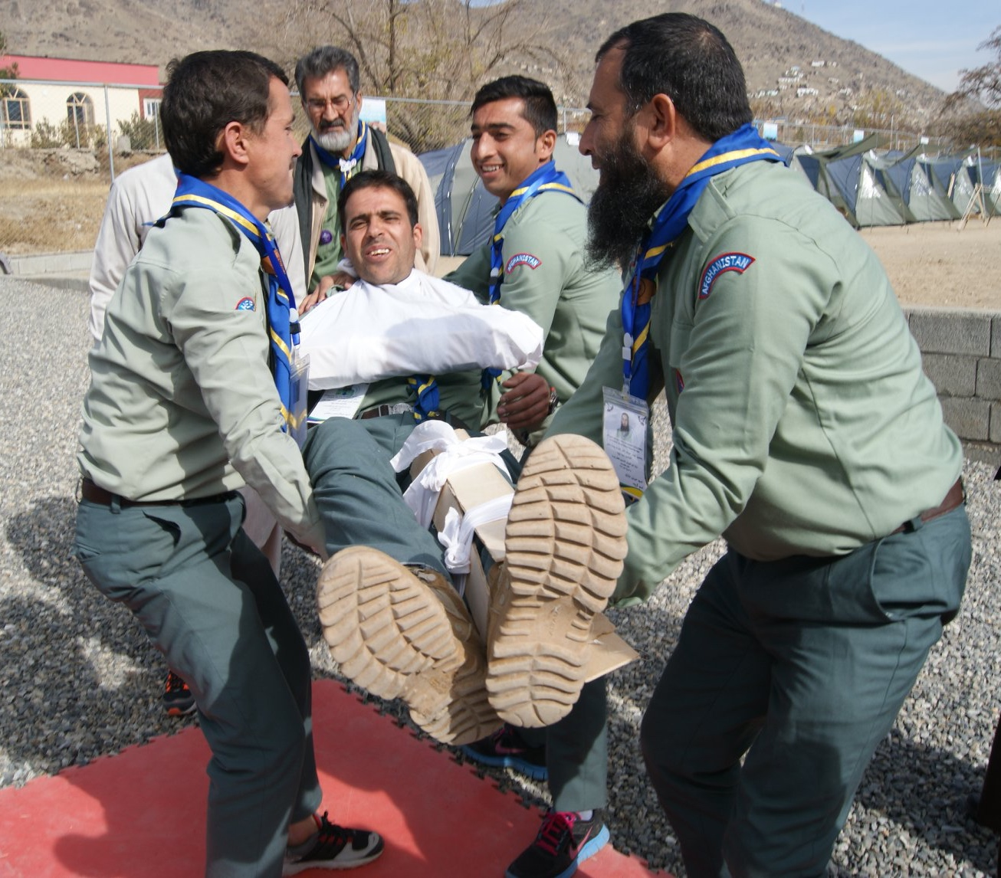
Activities: Scout Master Training
As the Scout program grows, new volunteer Scout Masters are recruited to start troops in their home provinces.
Volunteers attend week-long training sessions where they learn skills to become certified as Scout Masters.

Slide 11
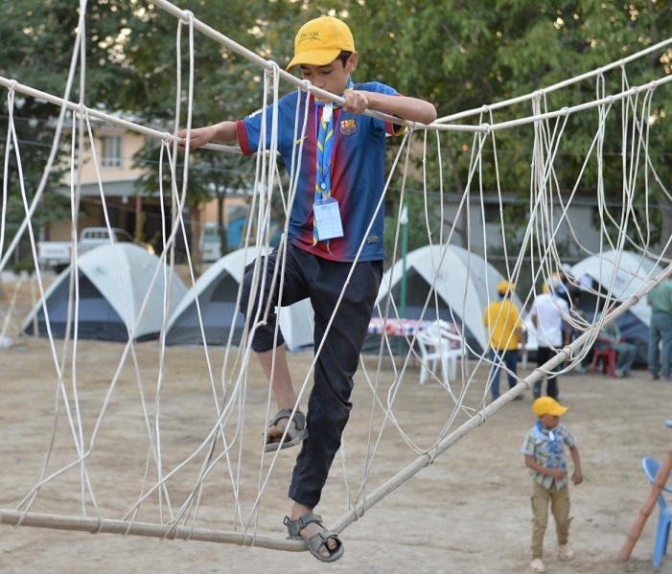
Activities: Camporee
Each summer, Scout youth from around the country travel to the National Scout Training Center to take part in a five-day campout.
Friendships are formed, skills are learned, and fun is had by all.

Slide 12
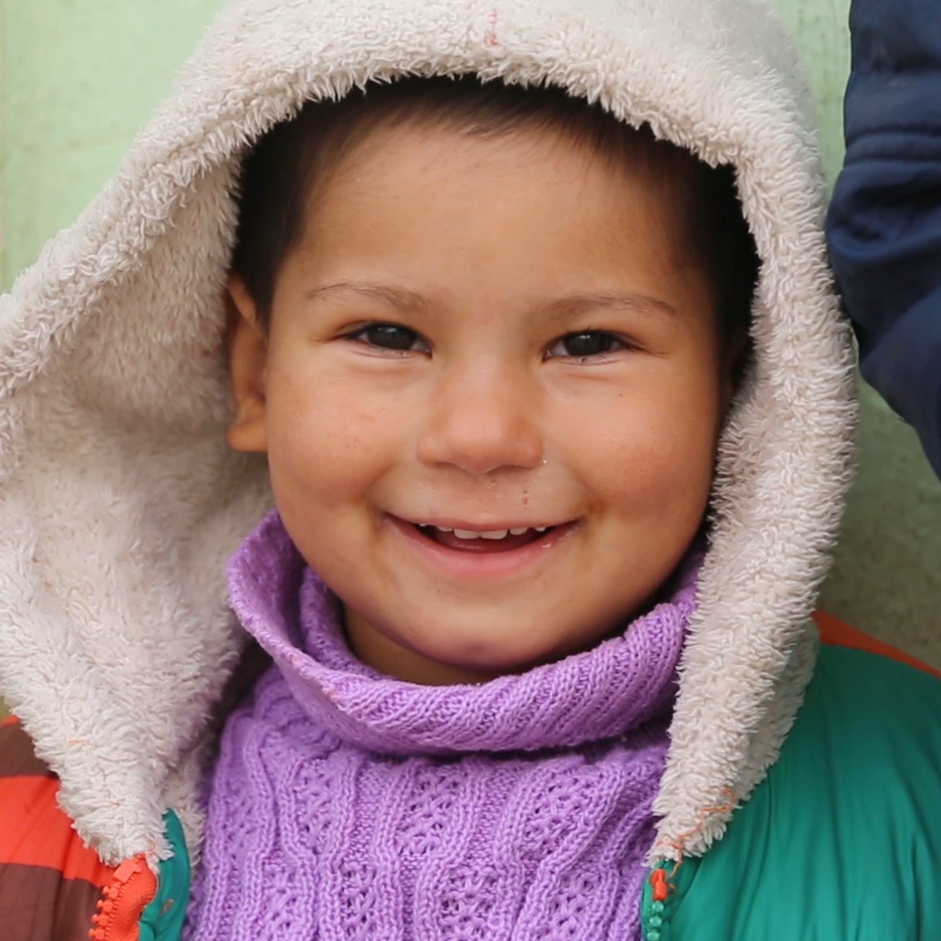
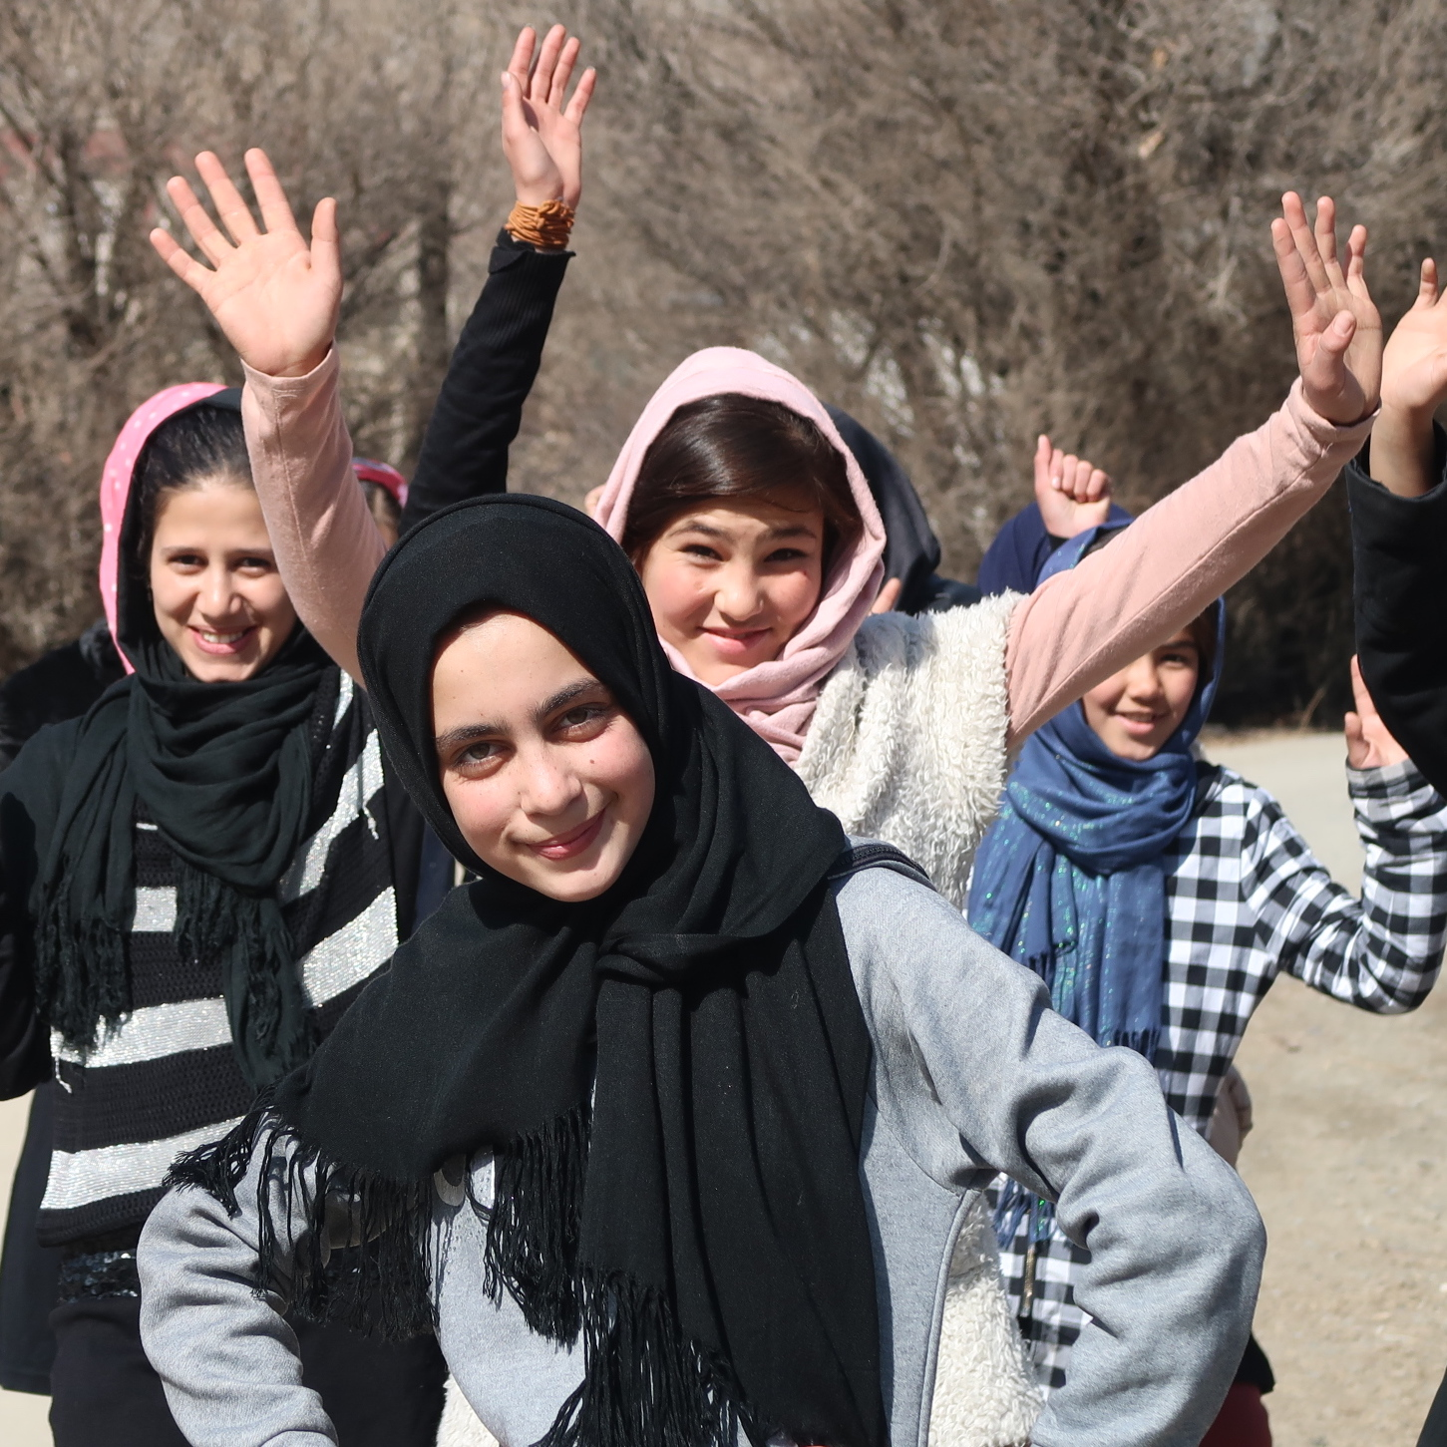
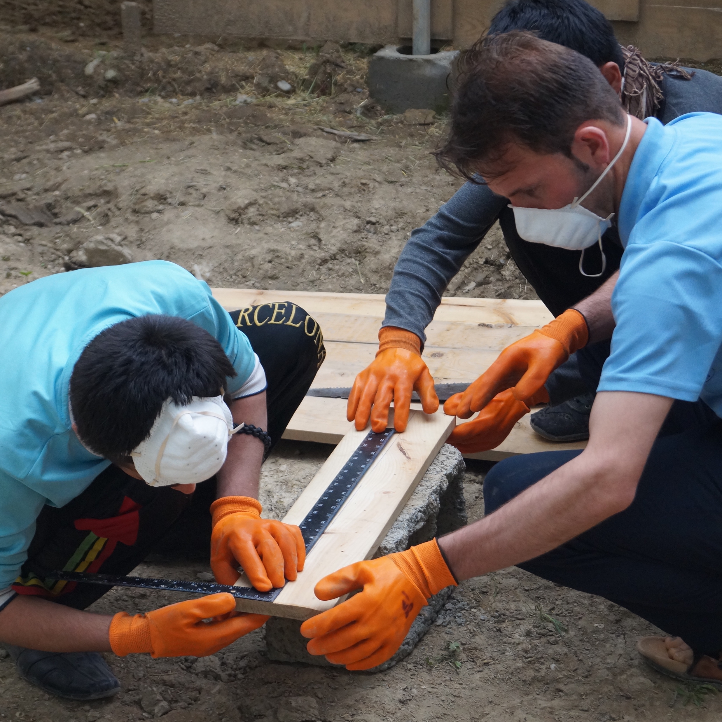
Scout Programs
Several unique programs have blossomed out of needs that we identified in our core Scout activities.
Voice of Afghan Youth
Sisters 4 Sisters
PARSA Job Corps

Slide 13
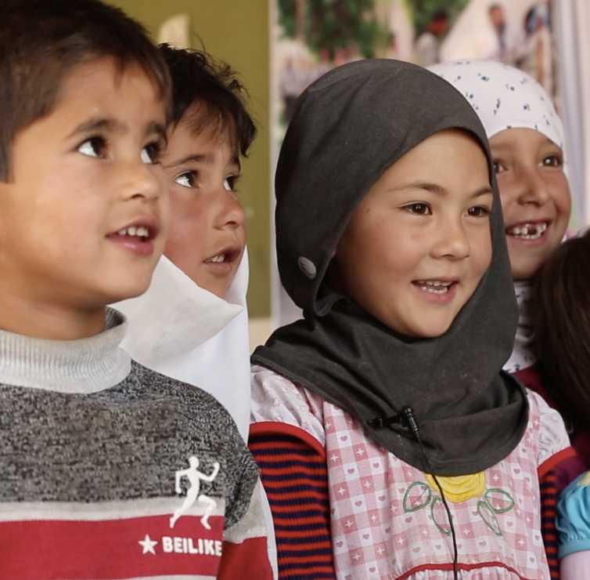
Voice of Afghan Youth
VoAY is a radio and television program that the Afghan Scouts produced in 2015.
VoAY episodes show Afghanistan through the eyes of its youth, and today we use the episodes to showcase the Afghan Scouts nationally and internationally.

Slide 14
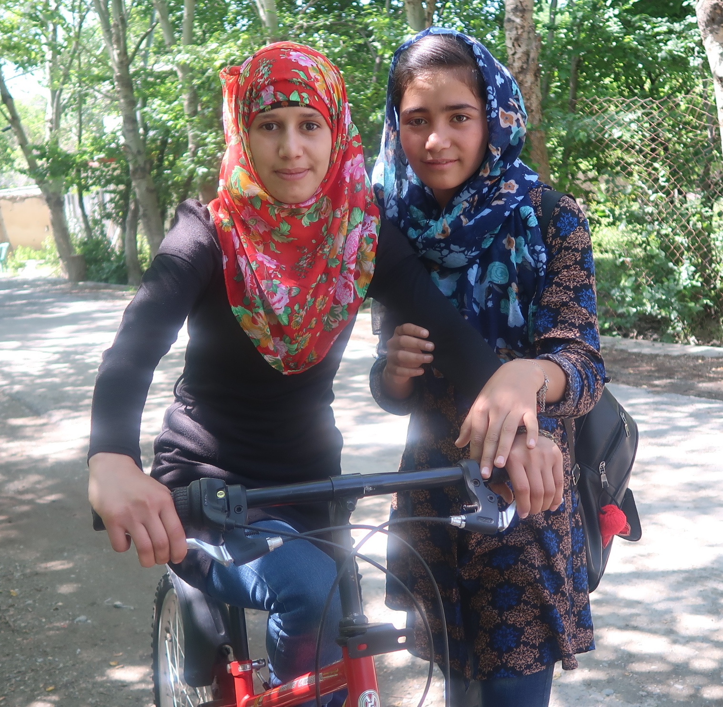
Sisters 4 Sisters
Sisters 4 Sisters is a mentorship program for young women and girls. It encourages participants to “find their voice” and develop confidence that carries over to all areas of their life – including participation in school and in Scouting activities.

Slide 15
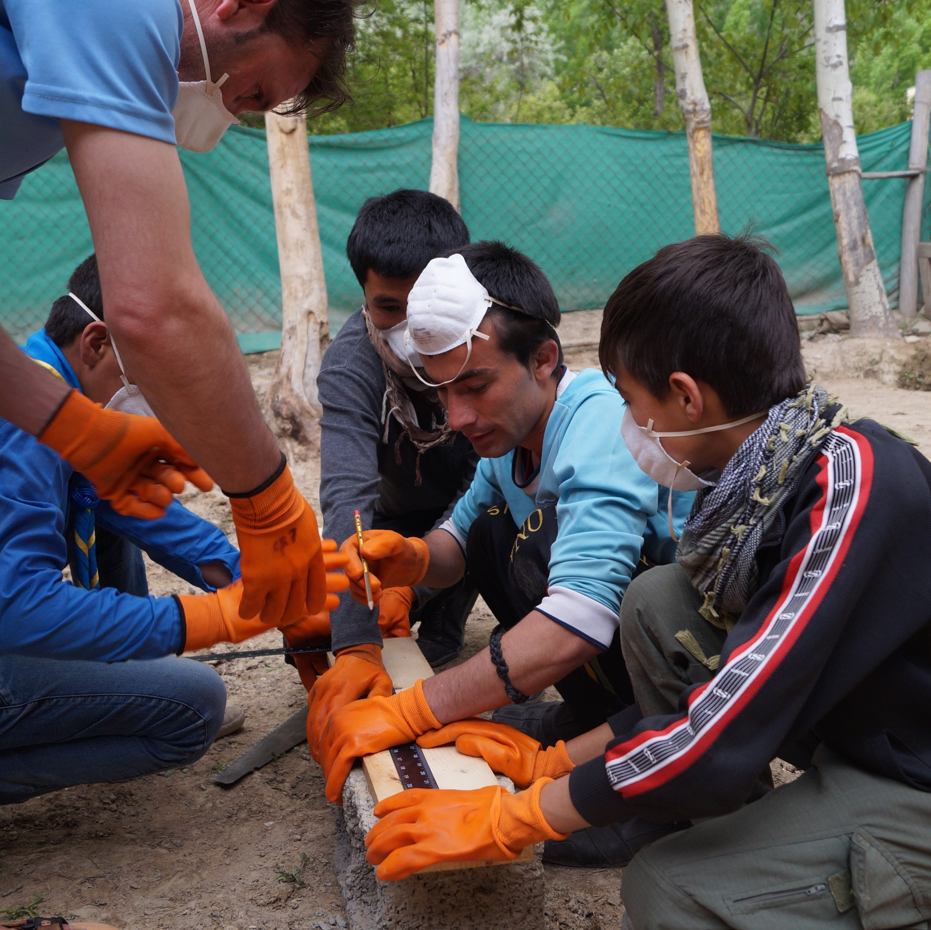
PARSA Job Corps
PARSA Job Corps is a vocational training program for youth to acquire new skills and learn responsibility.
They earn a small monthly stipend that goes to support their families and are required to stay in school.

Slide 16
PARSA’s Afghan Scouts
GET IN TOUCH:
www.afghanistan-parsa.org
Red Crescent Compound, Marastoon, Afshar, Kabul
info@afghanistan-parsa.org
Marnie Gustavson: +93(0)799 020 588

